Slide 1


Library Management System Project
Complete Student Guide: Installation, Code Explanation, Local Testing & Cloud Deployment
ReactJS + Express + MongoDB + Node.js
Presented By: L. ATRI DATTA RAVI TEZ | ASST. PROFESSOR & WEB ADMIN

Slide 2


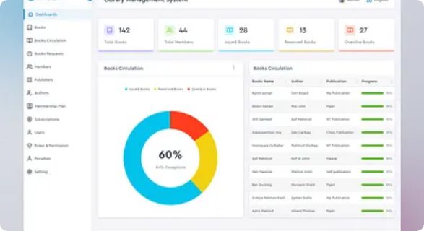
1. System Architecture & Workflow
Library Management System (LMS) full-stack architecture execution flow:
1. React UI Frontend (Client)
Book Catalog, Add Book Form, Issue Status & Author details manage chestundi.
2. Express REST API (Backend Server)
HTTP GET, POST, PUT, DELETE requests process chesi validation chestundi.
3. MongoDB Atlas (Cloud Database)
Books collection lo Book Title, Author, ISBN, Availability status store chestundi.
Data Flow:

Slide 3
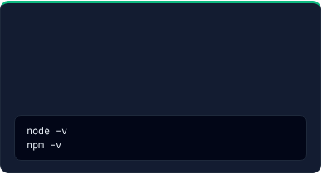


2. Software Installation Prerequisites
Full-stack development ki kaavalsina 3 essential software tools setup:
1. Node.js (Runtime)
2. VS Code (IDE)
3. MongoDB Atlas
Purpose: Express backend server run cheyadaniki and npm packages download cheyadaniki.
Purpose: Complete project code write cheyadaniki and terminal commands run cheyadaniki.
Purpose: Cloud database setup (Live deployment lo data persistent ga undadaniki).
Steps: Download LTS version from nodejs.org and verify:
Steps: Install from code.visualstudio.com with ES7 React Snippets extension.
Steps: Sign up on mongodb.com/cloud/atlas, create Free Cluster, set Network Access 0.0.0.0/0.
Key Note for Students:

Slide 4
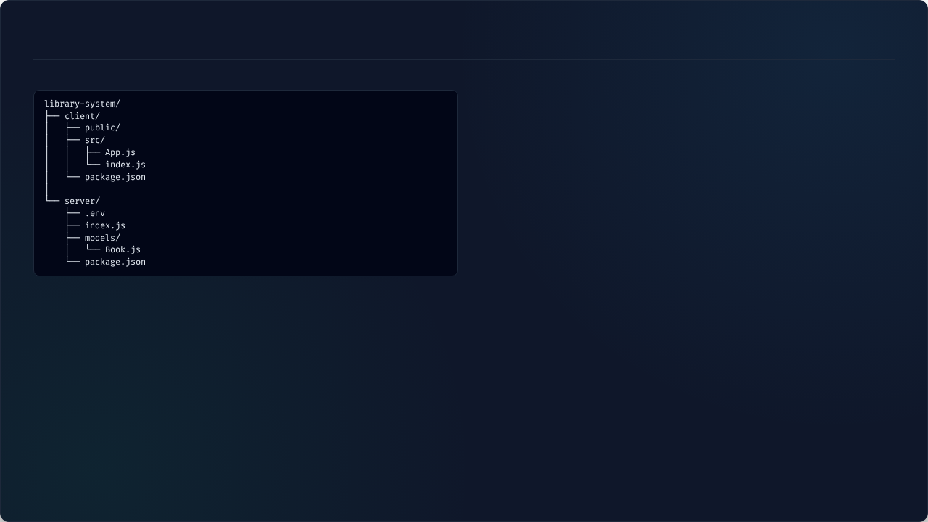
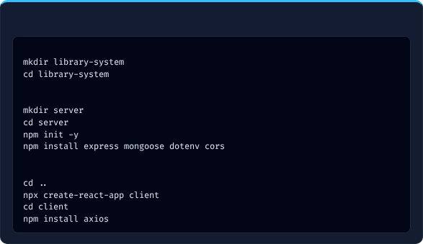
3. Project Folder Structure Setup
Main folder `library-system/` create chesi `client` and `server` folders organise chestam:
Terminal Commands to Initialize
# ReactJS Frontend
# 1. Create Main Project Folder
# Library Management UI
# React Entry Point
# 2. Setup Backend Folder
# Express.js Backend
# DB Connection URI & Port
# Express Server File
# Book Data Schema
# 3. Setup Frontend Folder (in separate terminal)

Slide 5
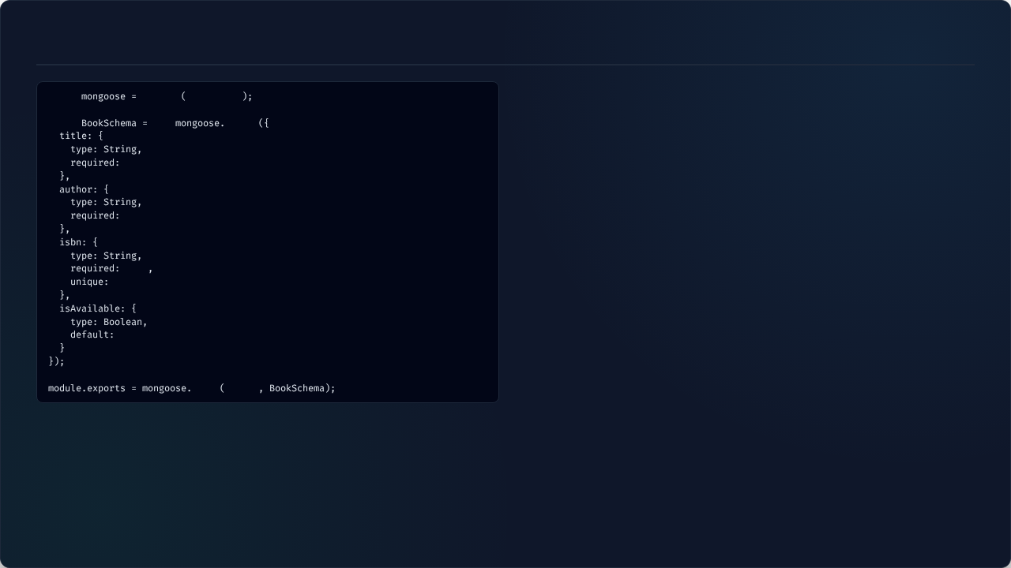


4. Book Model Code (server/models/Book.js)
const
require
'mongoose'
const mongoose = require('mongoose');
MongoDB database object modeling tool 'mongoose' ni project loki load chestundi.
const
new
Schema
const BookSchema = new mongoose.Schema({...})
true
Library Book Document ki kaavalsina fields (Title, Author, ISBN, Availability Status) rules define chestundi.
isbn: { unique: true }
true
Duplicate book entries padakunda prathi book ki Unique ISBN number constraint enforce chestundi.
true
module.exports = mongoose.model('Book', BookSchema);
true
Ee schema structure ni Express server controllers lo CRUD operations cheyadaniki export chestundi.
true
model
'Book'

Slide 6
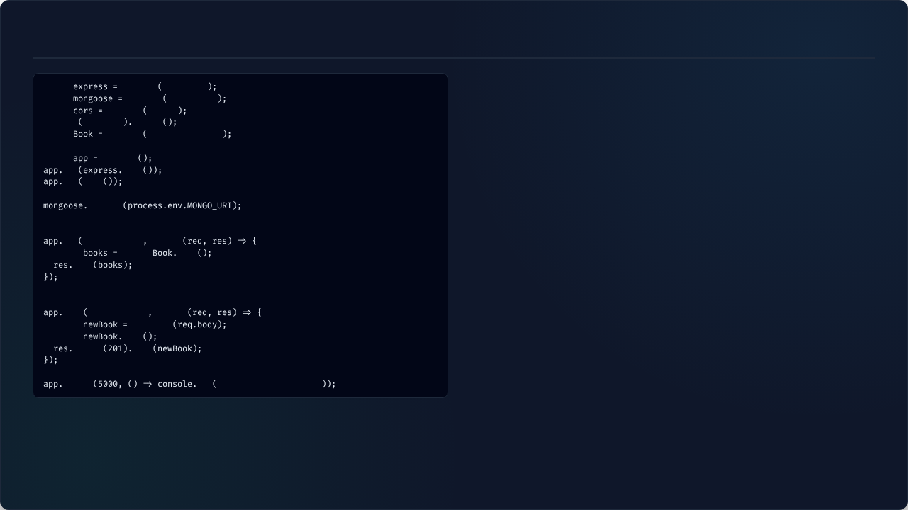
5. Express Server Code (server/index.js)
const
require
'express'
app.use(express.json());
const
require
'mongoose'
React Client form nunchi vachina Book JSON details request body lo read/parse chestundi.
const
require
'cors'
require
'dotenv'
config
app.use(cors());
const
require
'./models/Book'
Port 3000 (React) nunchi Port 5000 (Express) ki HTTP requests cross-origin restriction lekunda allow chestundi.
const
express
use
json
use
cors
mongoose.connect(process.env.MONGO_URI);
connect
`.env` file lo unna MongoDB Atlas cloud connection string tho Express backend ni connect chestundi.
// Fetch All Books
const books = await Book.find();
get
'/api/books'
async
MongoDB collection nunchi total Library Books catalog read chesi JSON response pampistundi.
const
await
find
json
// Add New Book
post
'/api/books'
async
const
new
Book
await
save
status
json
listen
log
"LMS Backend Running"

Slide 7
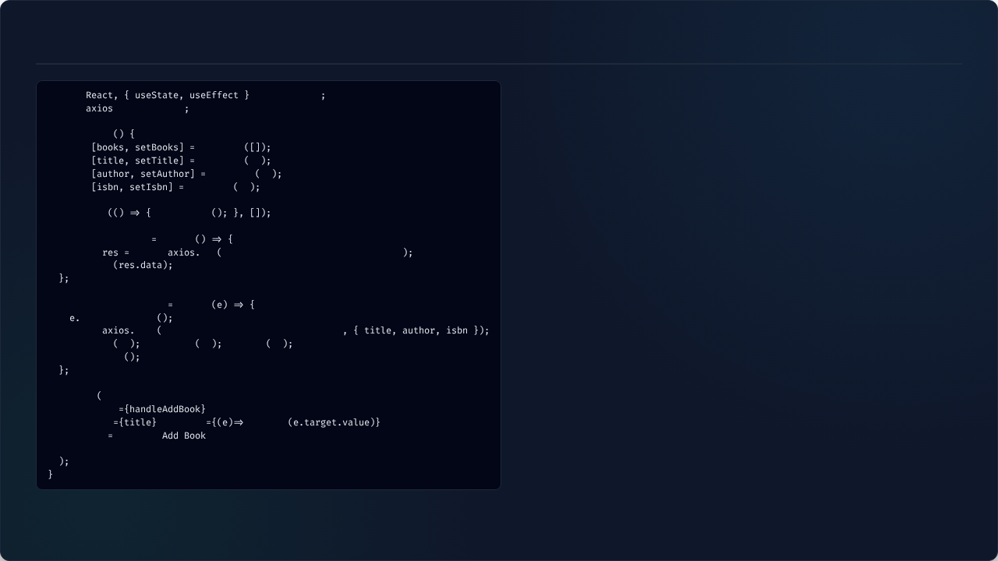


6. React Application Code (client/src/App.js)
import
from
'react'
const [books, setBooks] = useState([]);
import
from
'axios'
Database nunchi vachina Book catalog list state lo store chesi UI lo re-render chestundi.
function
App
useEffect(() => { fetchBooks(); }, []);
const
useState
React UI component first time render ainappudu automatic ga Backend GET API call chestundi.
const
useState
''
const
useState
''
const
useState
''
e.preventDefault();
useEffect
fetchBooks
Book details add chesinappudu page re-load avvakunda single page application experience isthundi.
const
fetchBooks
async
const
await
get
'http://localhost:5000/api/books'
await axios.post('http://localhost:5000/api/books', {...});
setBooks
Student add chesina New Book Title, Author, ISBN data ni Express backend dwara Cloud DB lo save chestundi.
const
handleAddBook
async
preventDefault
await
post
'http://localhost:5000/api/books'
setTitle
''
setAuthor
''
setIsbn
''
fetchBooks
return
onSubmit
>
value
onChange
setTitle
/>
type
"submit"
>

Slide 8
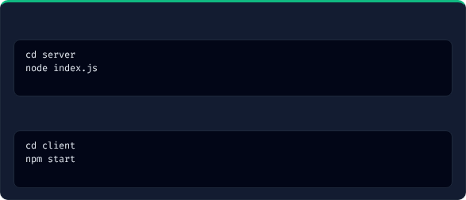

7. Local Testing & Output Verification
Step 1: Start Backend Server
Output Verification Checklist
✓
1. Open http://localhost:3000 in Chrome.
✓
2. Enter Book Title: "Clean Code", Author: "Robert Martin", ISBN: "9780132350884".
# Terminal Output: LMS Backend Running on Port 5000
✓
3. Click **Add Book** button.
Step 2: Start Frontend Client
✓
4. New Book immediate ga Screen pyna Table List lo kanipisthundi.
✓
5. MongoDB Atlas Cluster dashboard open chesi Document save aindhi lenidhi verify cheyandi!
# Opens http://localhost:3000 in browser
Local Result:

Slide 9

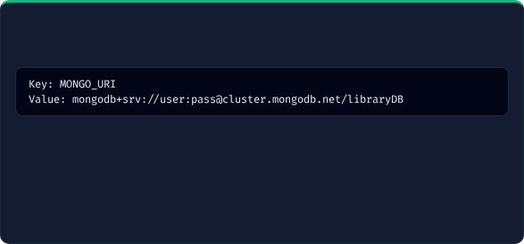
8. Backend Cloud Deployment (Render)
Step 1: Push Project to GitHub
Step 3: Add Environment Variables
✓
Create new Repository on GitHub.
Render Dashboard lo Environment Section lo credentials setup cheyandi:
✓
Ensure `.env` file is inside `.gitignore`.
✓
Push `server/` code to GitHub repository.
Step 2: Setup Service on Render
✓
Login to render.com & click **New Web Service**.
Live Backend API URL:
✓
Set Root Directory: server
✓
Set Build Command: npm install
✓
Set Start Command: node index.js

Slide 10
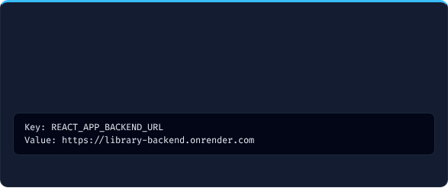

9. Frontend Deployment & Live Output
Vercel Deployment Steps
Live Production Verification
✓
1. Open vercel.com and Sign in with GitHub.
✓
Vercel nunchi vachina Live Website URL open cheyandi.
✓
2. Select GitHub Library Project repository.
✓
New Book Title & Author add chesi submit kottandi.
✓
3. Set **Root Directory** as client.
✓
Data live MongoDB Cloud DB lo store aiyi instantly reload lekunda catalog update avuthundi!
✓
4. Add Environment Variable:
🎉 Congratulations!
✓
5. Click **Deploy**!

Slide 11

Image Sources
https://cdn.dribbble.com/userupload/45536564/file/7ec6f536b0ec9b4e6d5f9ae11302a57a.png?format=webp&resize=400x300&vertical=center
Source: dribbble.com

